Slide 1
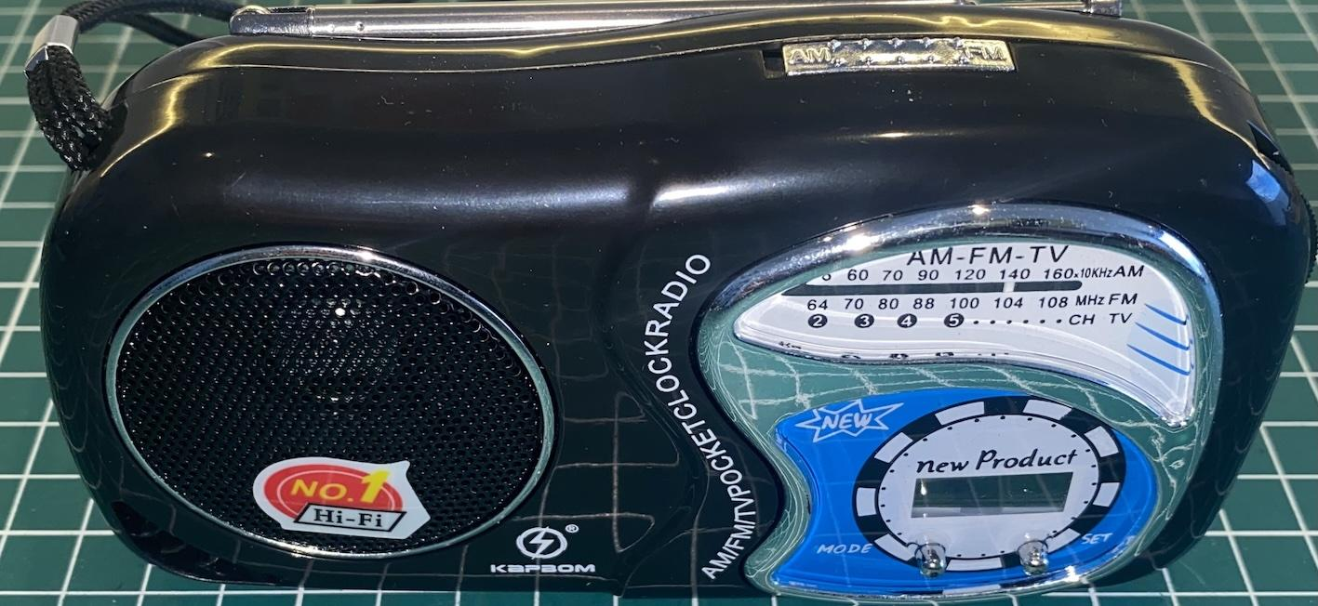
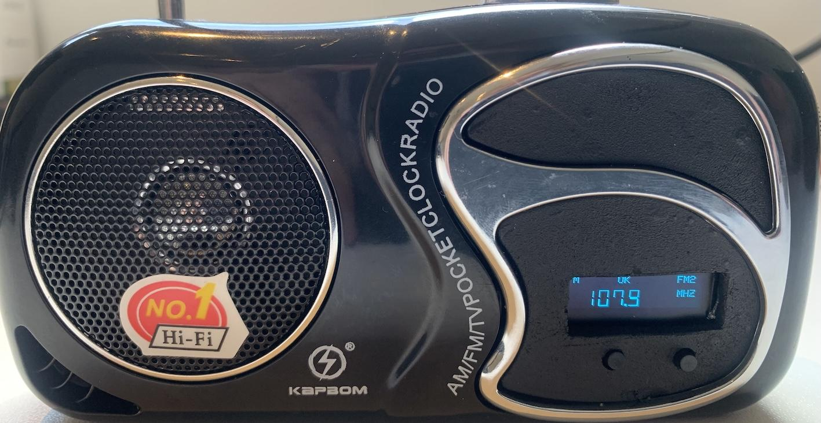
Converting a low-cost radio based on the Si4825 into a digital interface radio using the Si4827.

Slide 2
About the low-cost radio (KapBom K2019)
Two bands (MW and FM)
Less than $5
Compact and lightweight
Based on the Si4825 DSP
Sturdy plastic casing
Analog interface
Warning: There are other receivers from different manufacturers that use the same casing but are not
equipped with the Si4825. Be sure the receiver is equipped with the Si4825.

Slide 3
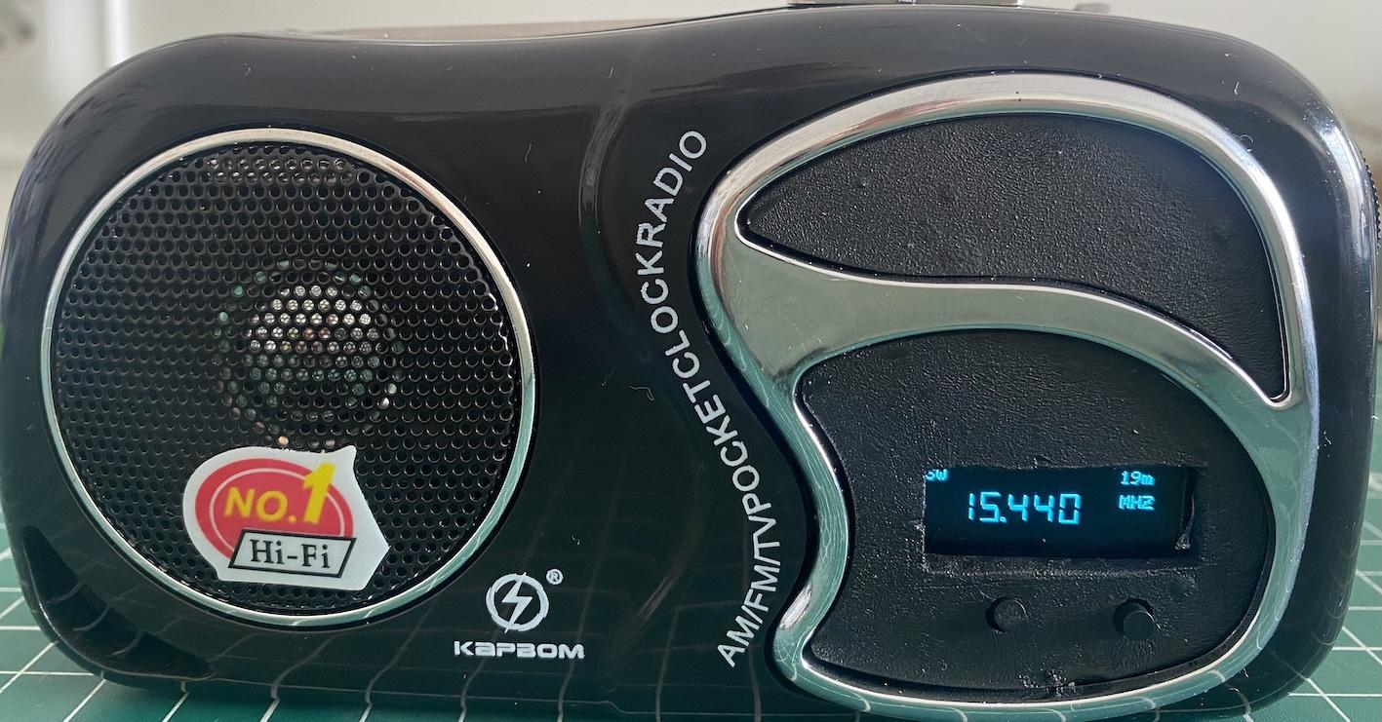
About the modified radio
15 bands (3 FM, 2 AM, and 10 SW)
Bands can be configured via programming
Based on the Si4827 DSP
Uses the Seeeduino XIAO controller (ARM Cortex-M0+)

Slide 4
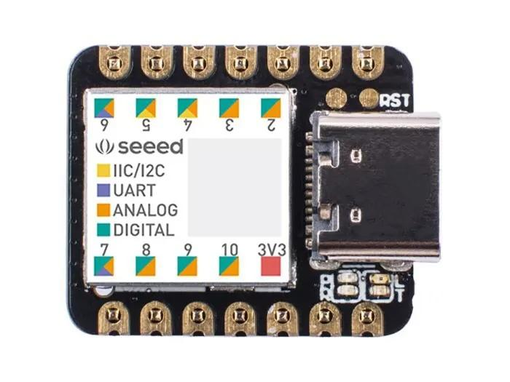
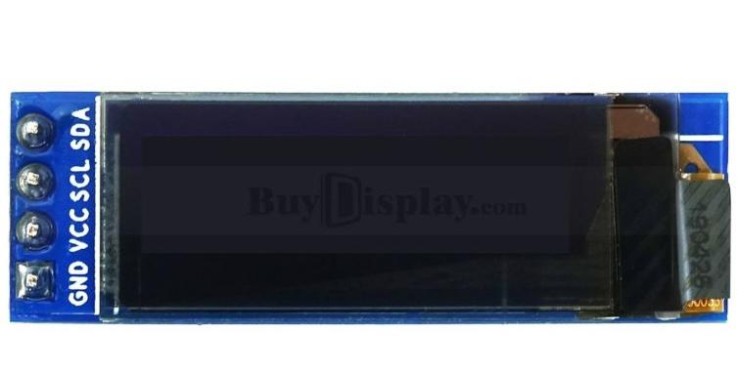
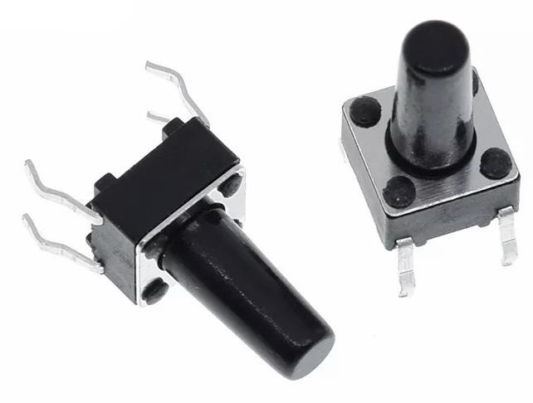
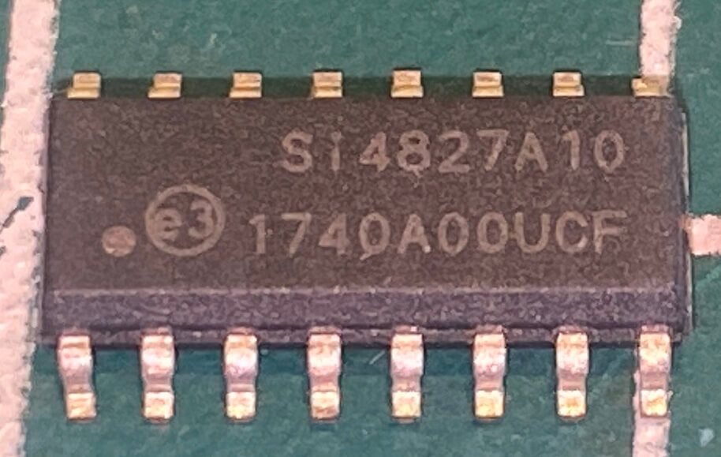
Components used for the modification
OLED I2C
Push Buttons
SEEEDUINO XIAO
ARM Cortex-M0+
SI 4827

Slide 5
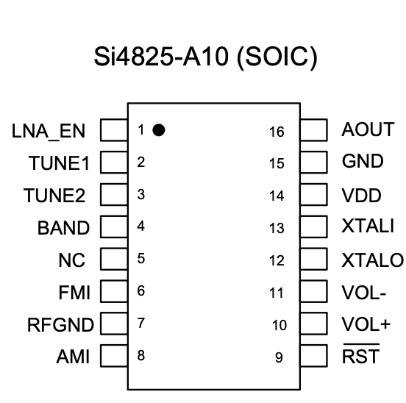
About the DSP Si4825
Support for FM band (64–109 MHz)
Support for AM band (504–1750 kHz)
Support for SW band (2.3–28.5 MHz)
No manual calibration required
Mono audio output
Band configuration according to region (AM/FM/SW)
Enhanced coverage for FM/SW bands

Slide 6
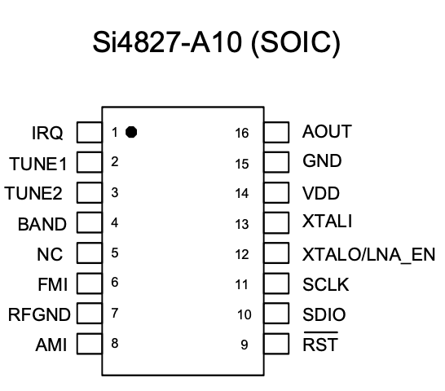
About the DSP Si4827
Support for FM band (64–109 MHz)
Support for AM band (504–1750 kHz)
Support for SW band (2.3–28.5 MHz)
Selectable support for all regional AM/FM/SW bands
Enhanced coverage of FM/SW bands
2-wire control interface (I2C)
Valid station indicator
Support for digital volume control
Support for bass and treble adjustment

Slide 7
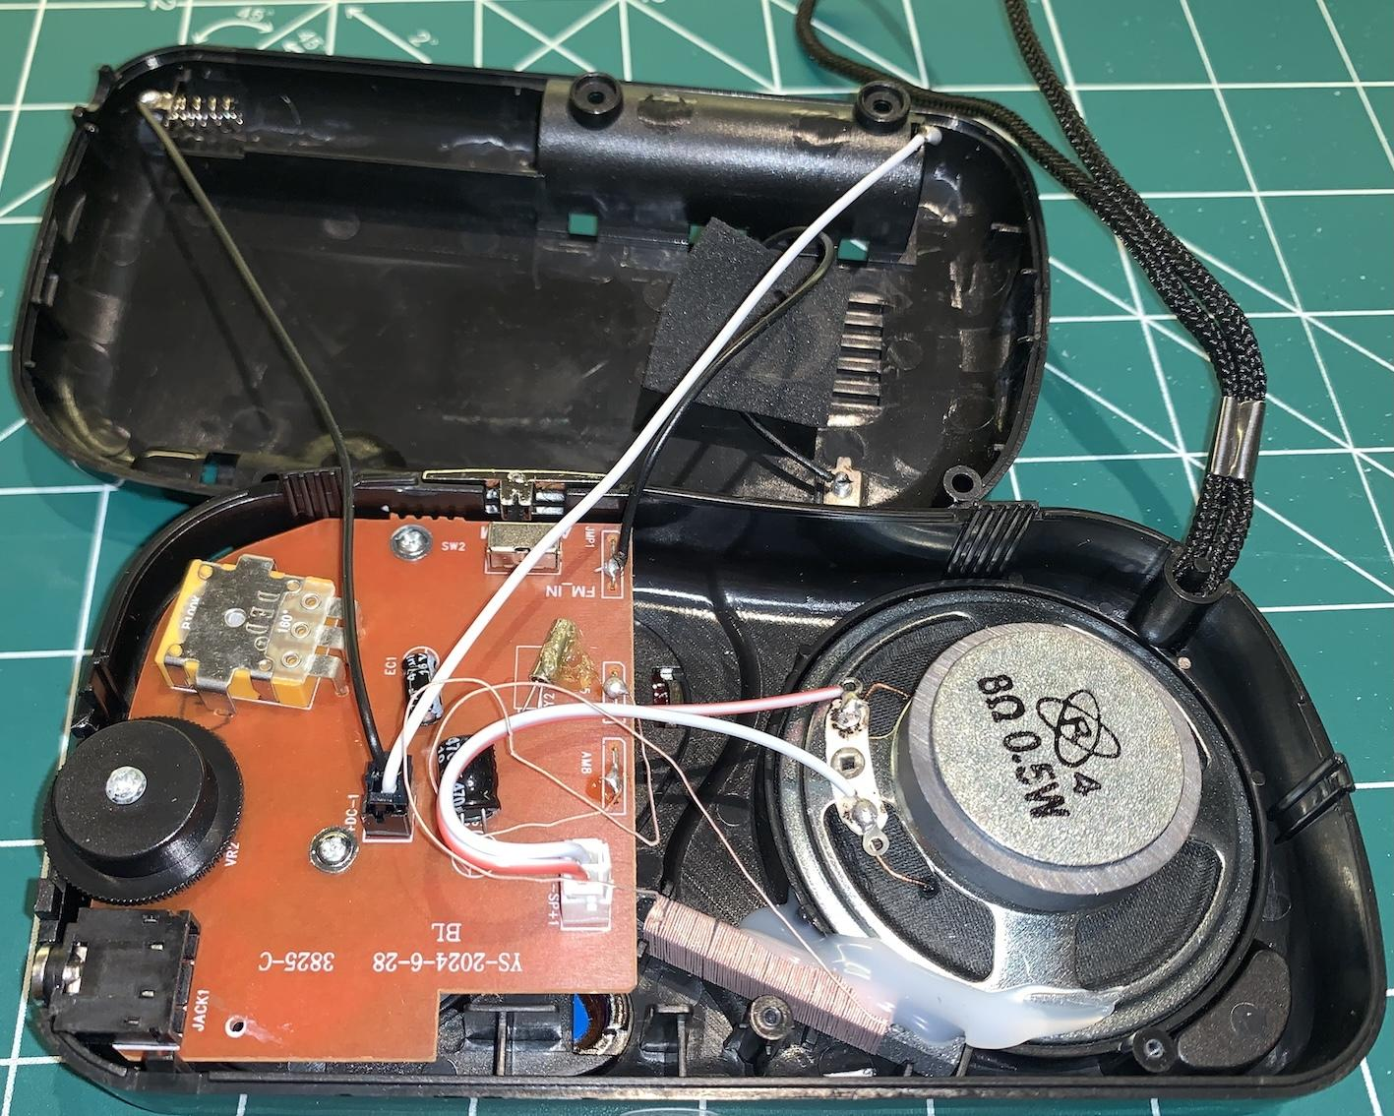
Open radio (before modification)
Notes:
This is the KapBom K-2019 radio opened. As you can see, it has few components.
It is important to highlight that the Si4825 DSP, as well as other SMD components, are on the bottom side of the PCB, as we will see next.

Slide 8
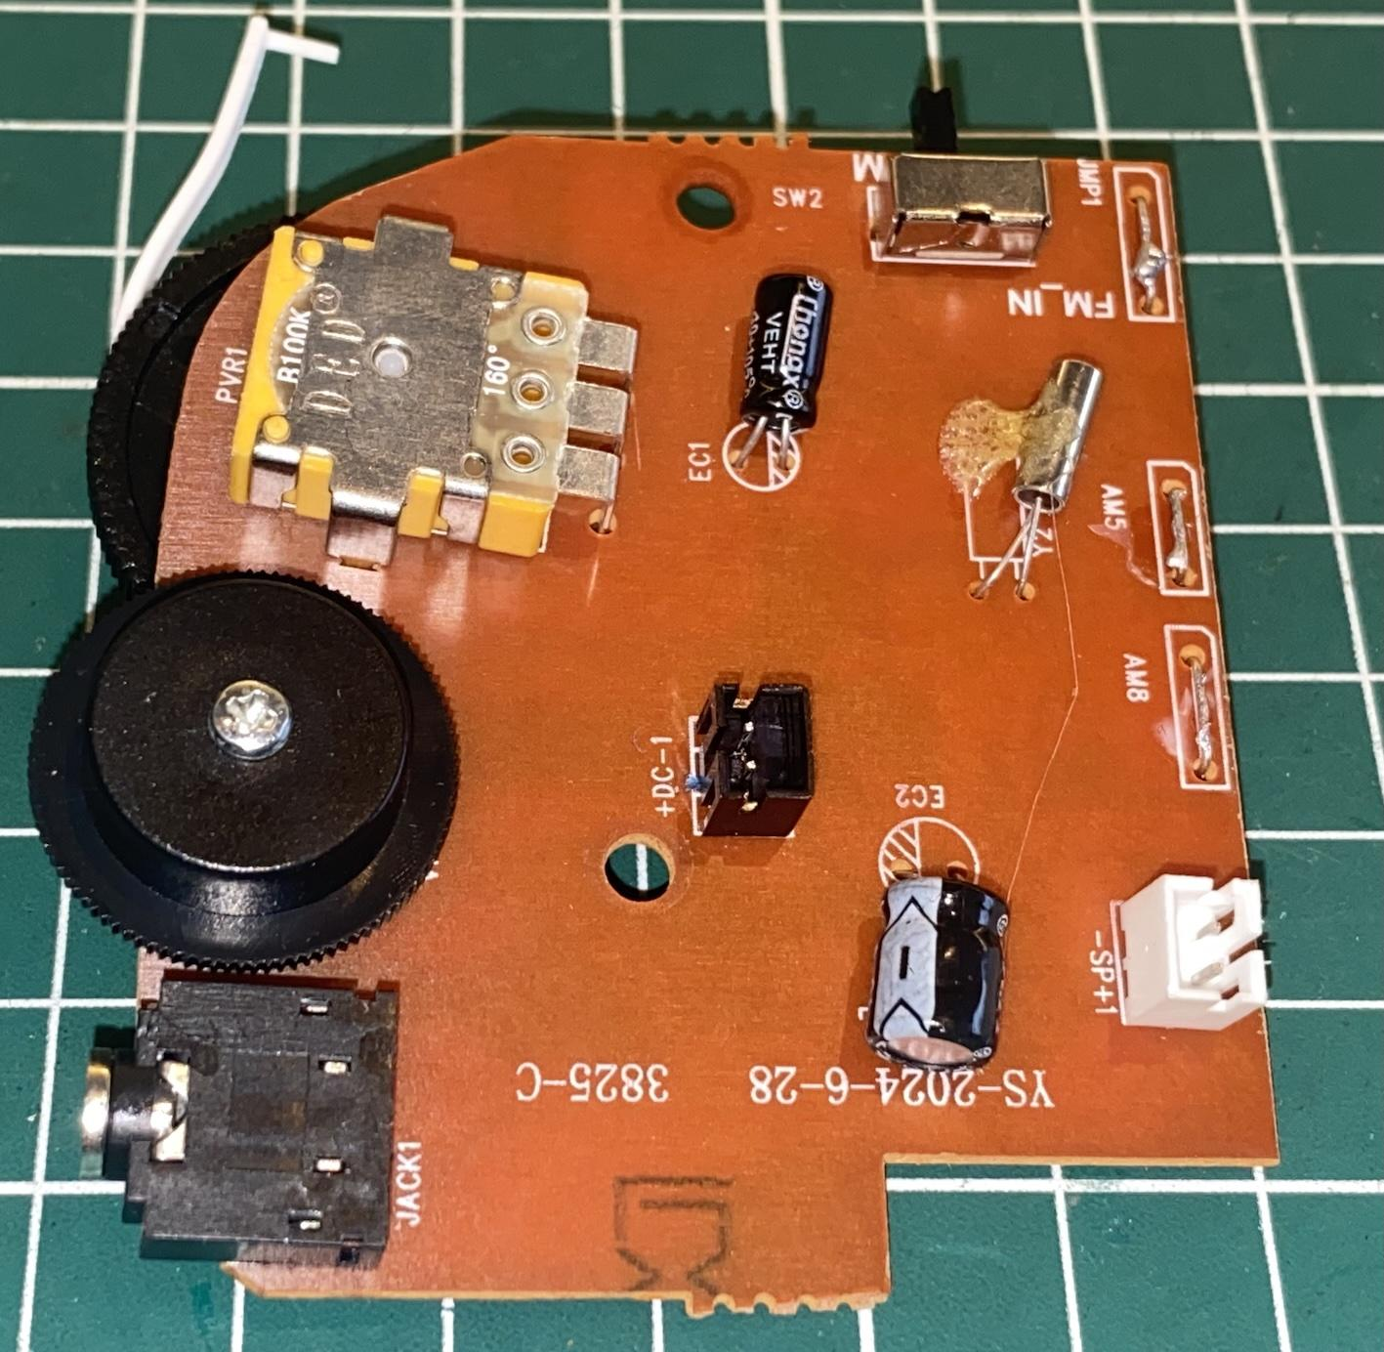
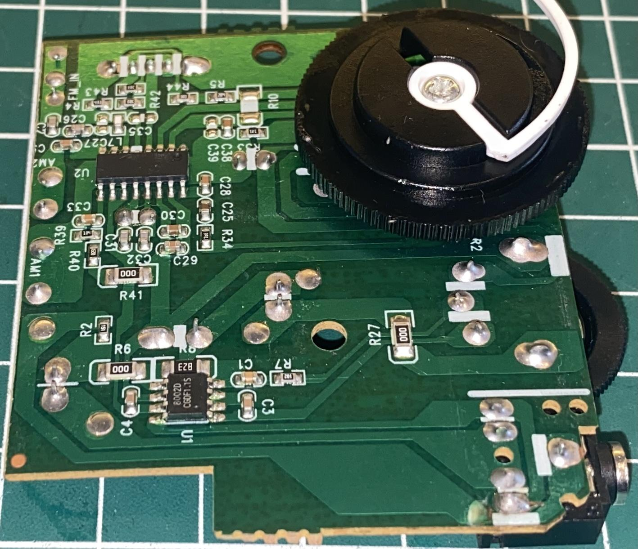
Board (before modification)
Notes:
Here we have the top and bottom views of the board. On the right, observe the Si4825 (the larger IC), an audio amplifier based on the 8002, and some passive SMD components (resistors, capacitors, and inductors).

Slide 9
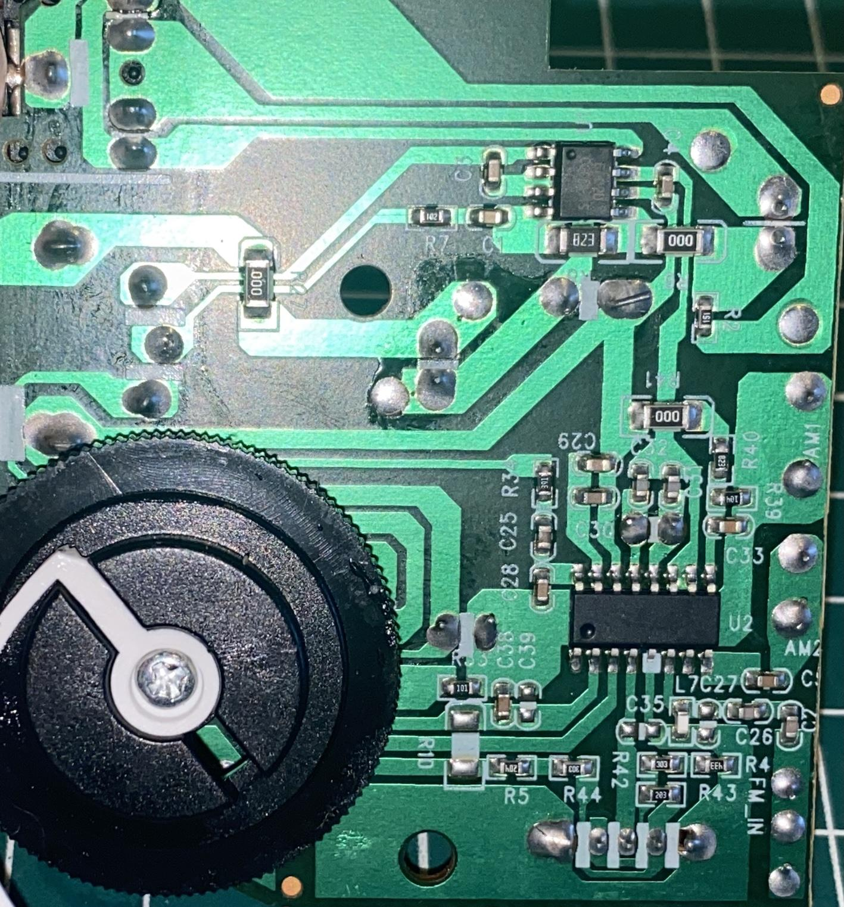
Si4825 Identification (Check if the radio is based on Si4825)
Notes:
To verify if the DSP IC is indeed a Si4825, check the pin specifications. Pin 1 (LNA_EN) usually has no function or is connected to an external RF amplifier. In this radio, it has no function, as can be observed on the PCB. Pins 2 and 3 are connected to the 100K tuning potentiometer. Pin 4 is the band selection pin, which is connected to a switch that toggles a voltage divider (resistor bank). Depending on the voltage entering pin 4, a specific band is selected. In this radio, there are only two bands (MW and FM). Pin 5 has no function in the IC; note that on the PCB, it is isolated. Pins 6, 7, and 8 are the FM input, GND, and AM input, respectively.
Pin 9 is the reset pin, which is connected to a resistor-capacitor network to lower the voltage level of this pin to 0V when the radio is turned on and then raise it to 3V.

Slide 10
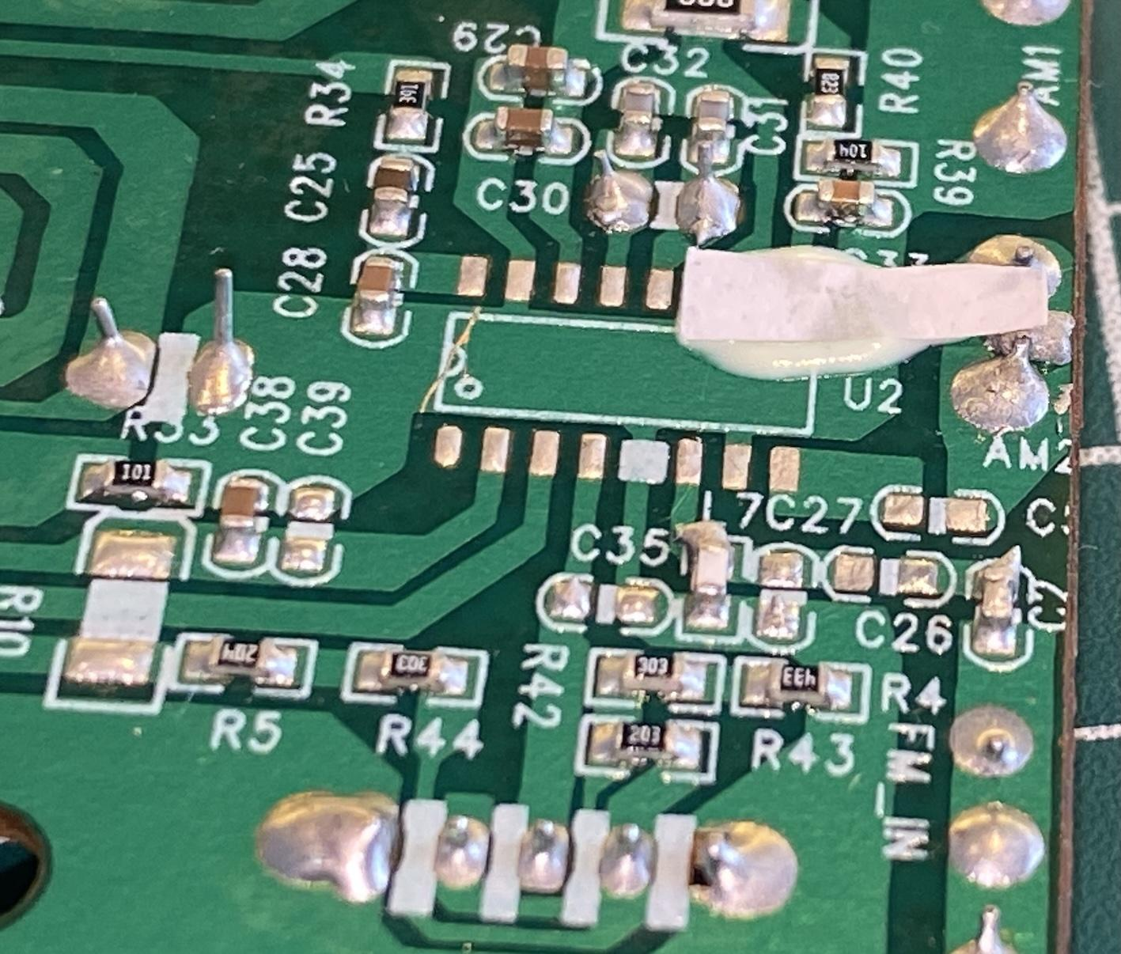
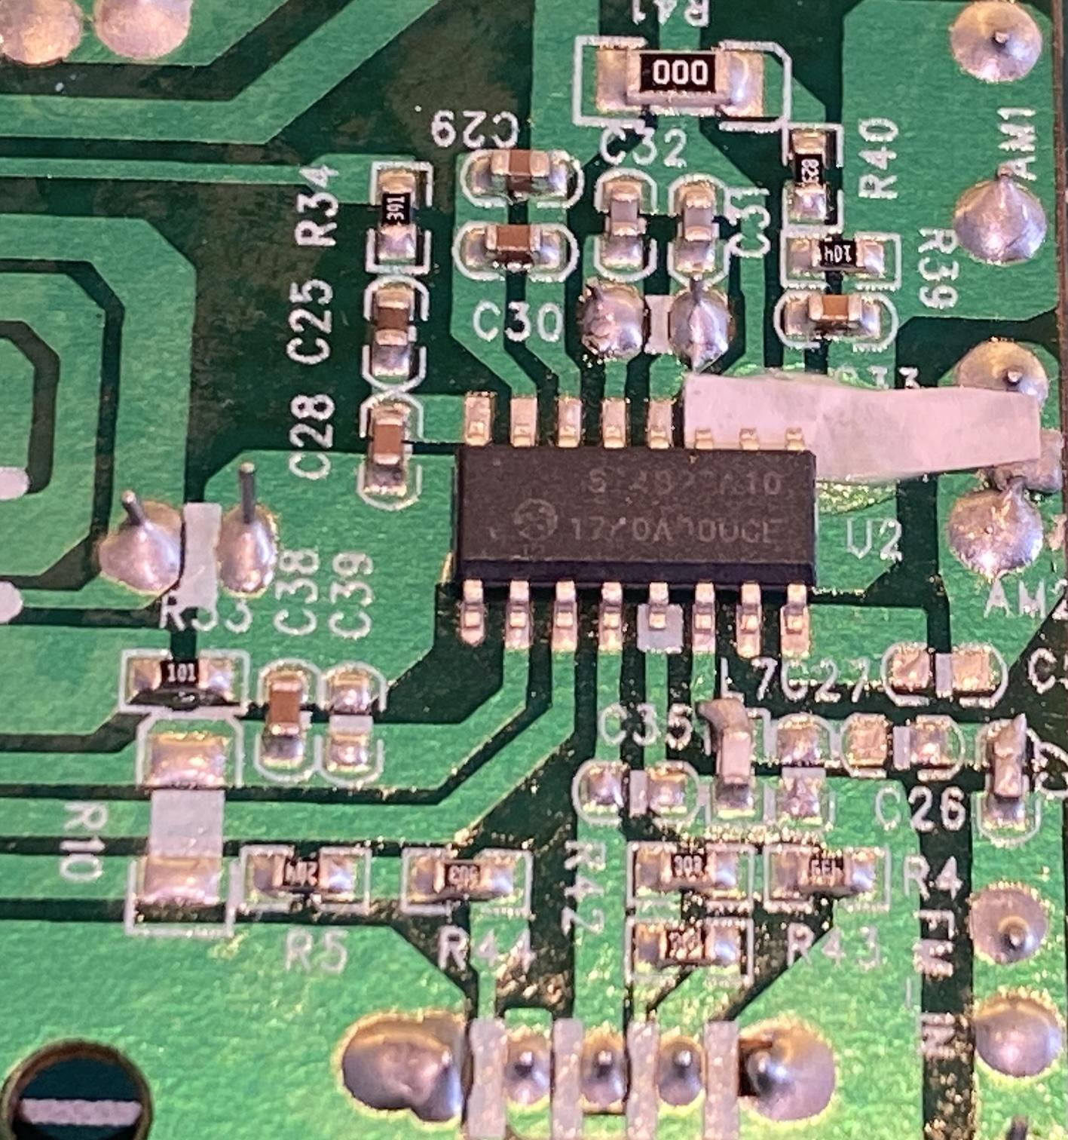
Replacement of Si4825 with Si4827
Notes:
Observe in the figures that pins 9, 10, and 11 of the Si4827 have been isolated from the PCB. Pin 1 did not require an isolator because, in this project, pin 1 of the Si4825 was not used (it is soldered to the PCB but has no function).

Slide 11
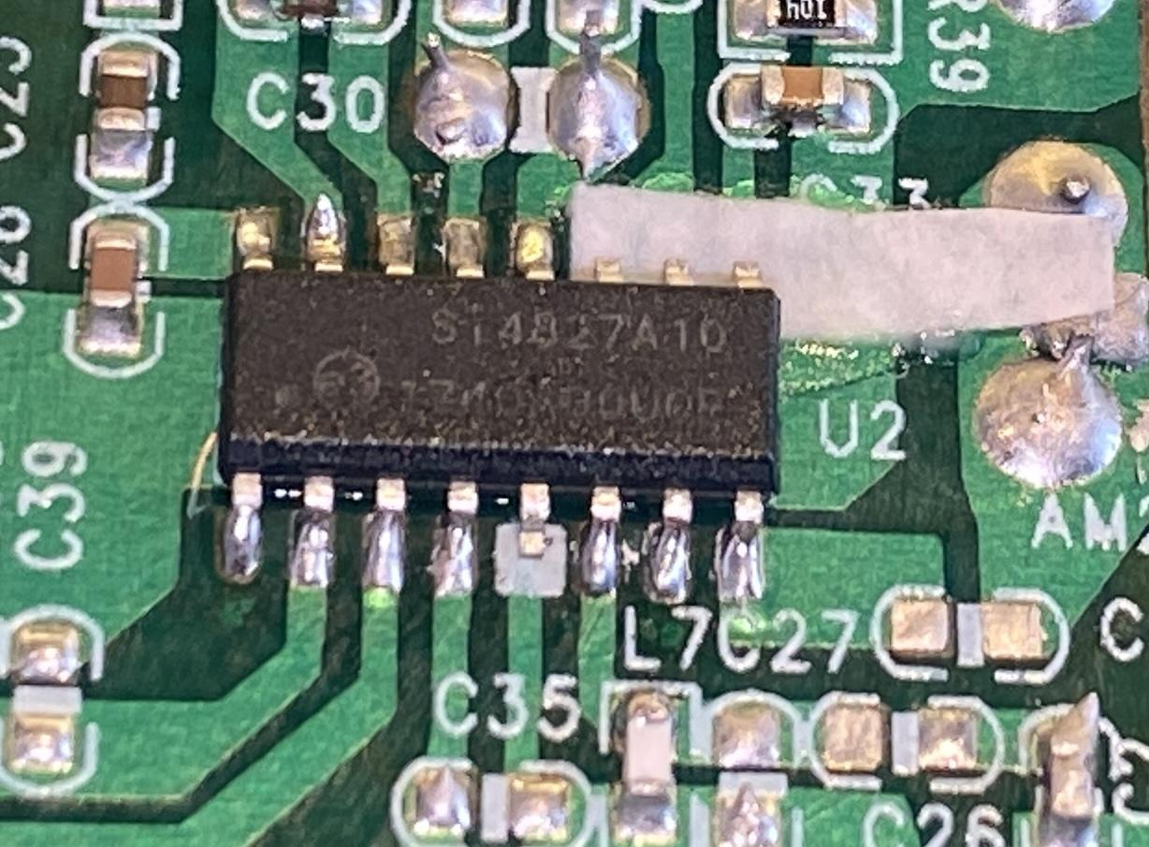
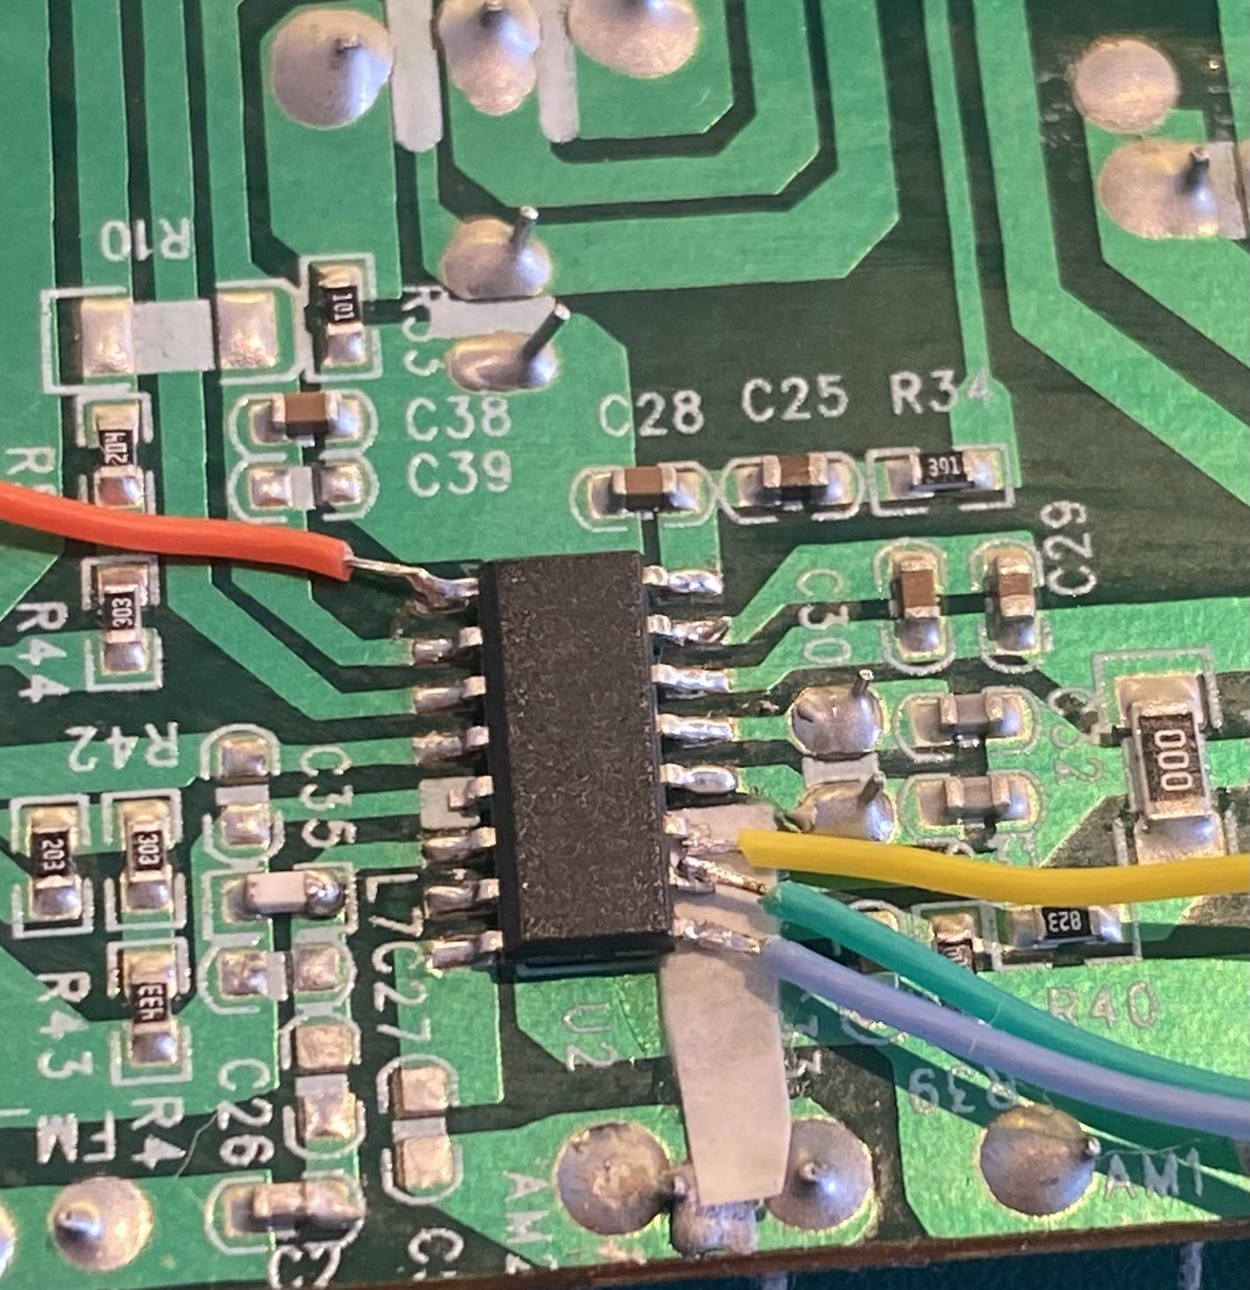
Si4827 soldered on the board
Notes:
The removal of the Si4825 must be done with great care. The same level of caution should be applied when soldering the Si4827 and connecting it to the Arduino or another microcontroller. Essentially, four wires from the Si4827 will be isolated from the PCB (with no interaction with it) and connected directly to the Arduino or an equivalent device. Extra care is required when handling the wires after soldering. Under no circumstances should they put tension on the IC's pins. Believe me, even the slightest strain can break an IC pin.

Slide 12
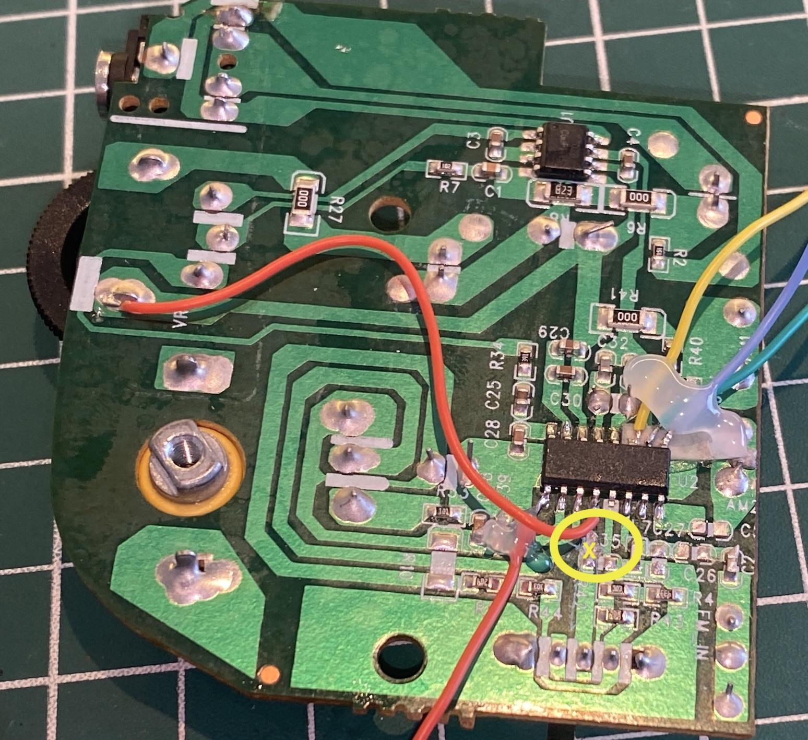
Si4827 with a cut on the trace leading to pin 4 (BAND)
Notes:
Observe in the figure that pin 4 of the Si4827 is isolated from the PCB by cutting the trace and connected to the +VCC of the PCB. This procedure allows band selection to be controlled via the Arduino. This way, it will be possible to select any of the 40 pre-defined bands by the DSP.

Slide 13
Si4827 and Seeduino XIAO wireup
| SI4827 pin | SEEEDUINO pin | Description |
| --------- | ------------ | ----------------------------|
| 1 | 2 | SEEEDUINO interrupt pin |
| 9 | 6 | RESET |
| 10 | A4 (SDA) | I2C bus (Data) |
| 11 | A5 (SCL) | I2C bus (Clock) |
| -----------| ------------- | ----------------------------|
| OLED | | |
| -----------| ------------- | ----------------------------|
| SDA | 4 | I2C Bus (Data) |
| CLK | 5 | I2C bus (CLock) |
| -----------| ------------- | ----------------------------|
|Push Buttons| | |
| -----------| ------------- | ----------------------------|
| BAND UP | 7 | Next Band. |
| BAND DOWN | 8 | Previous Band |

Slide 14
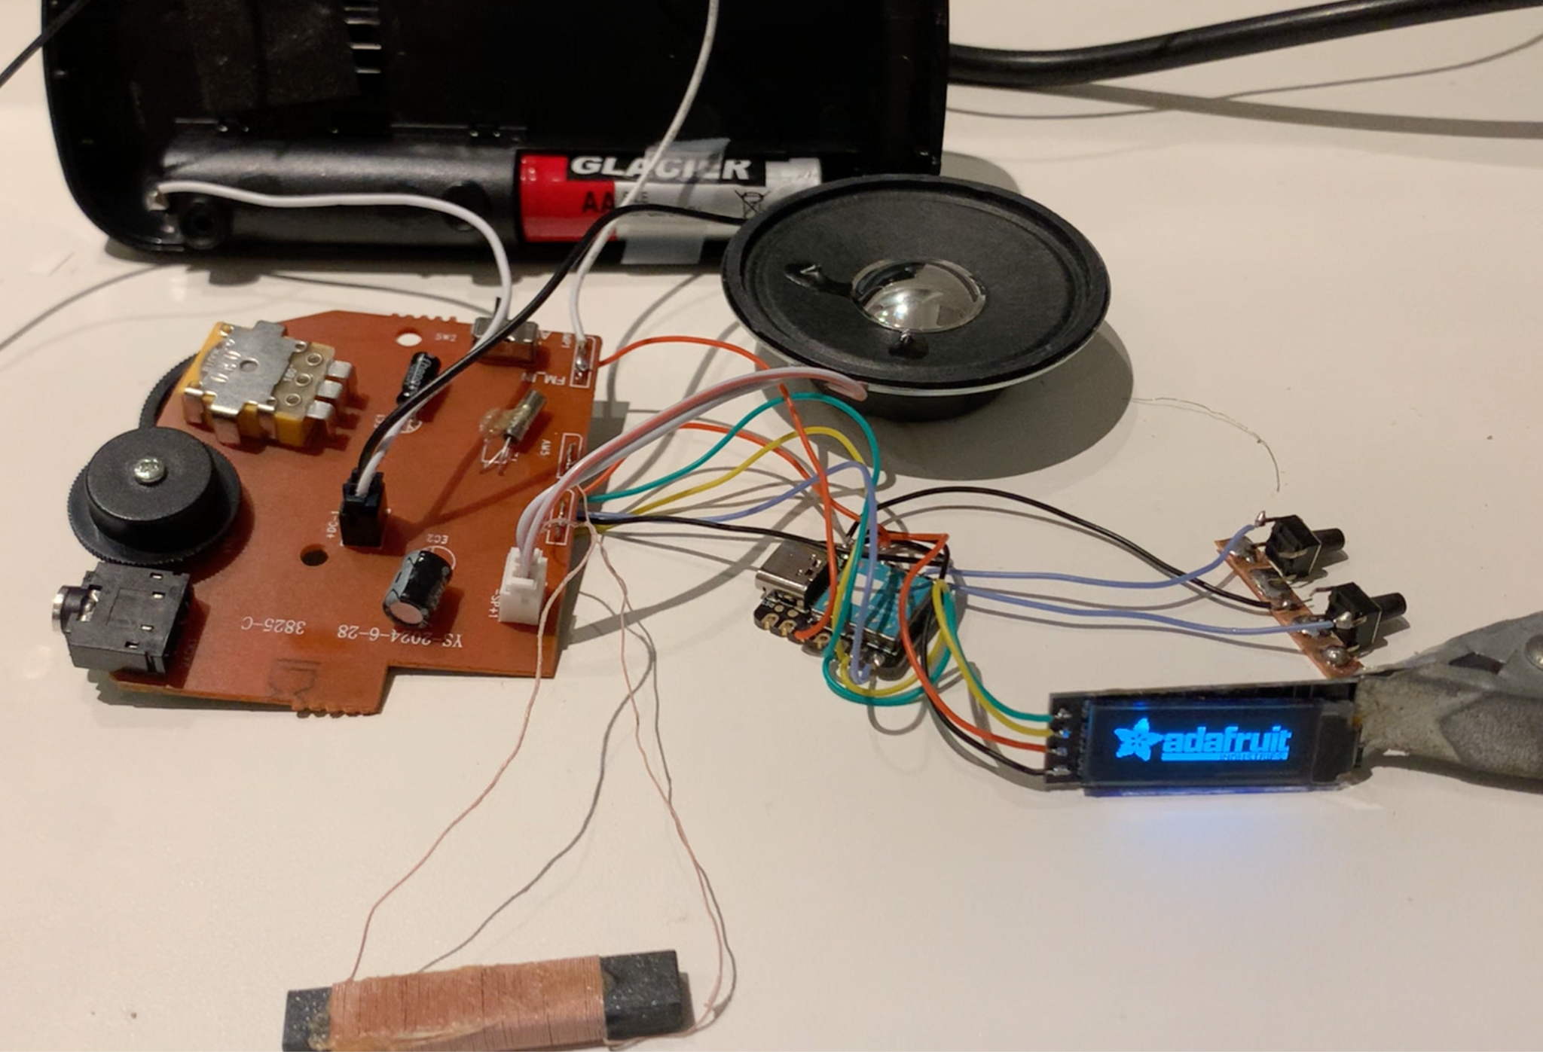
Checking the Si4827 and Seeduino XIAO setup

Slide 15
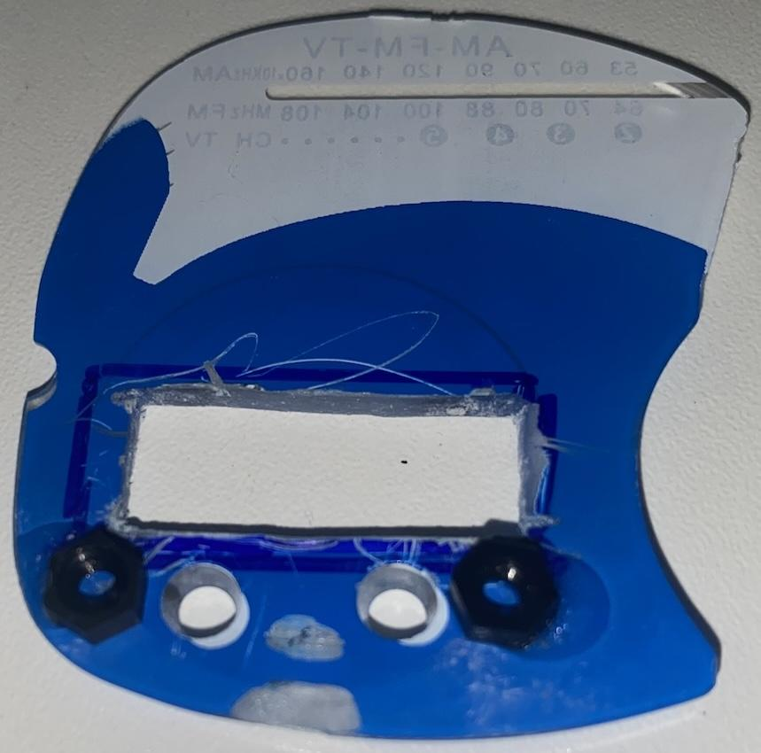
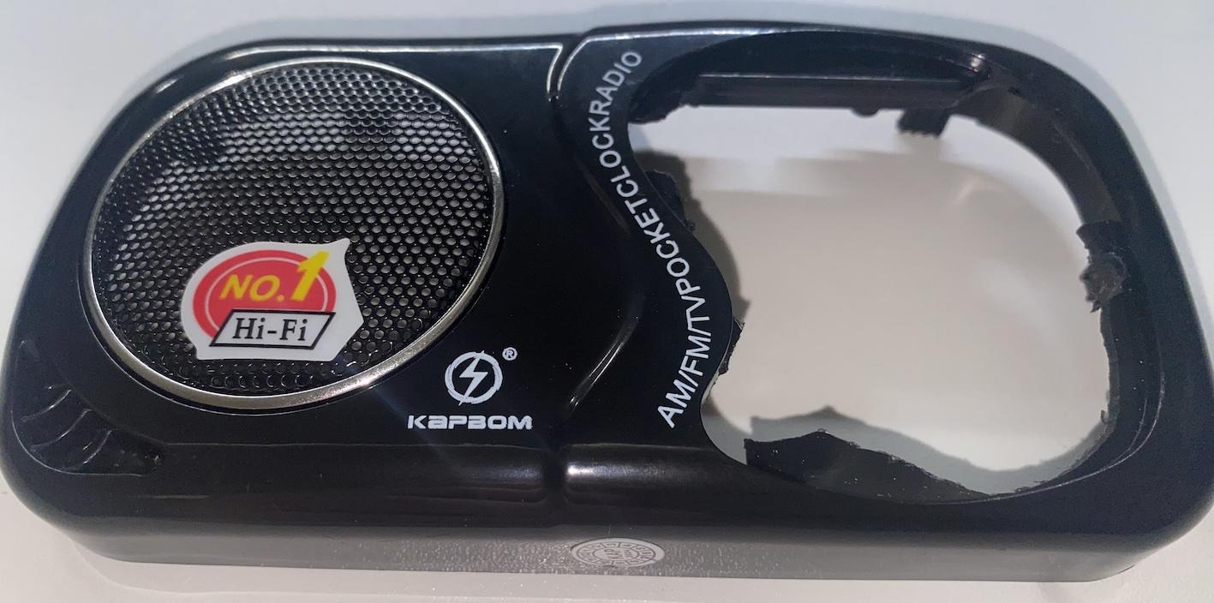
Case modification

Slide 16
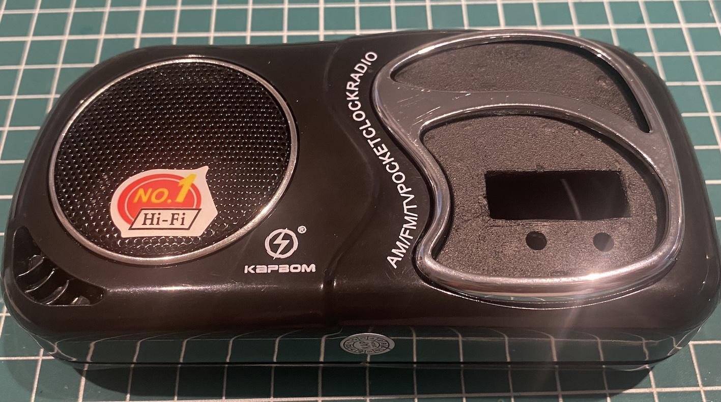
Case modification

Slide 17
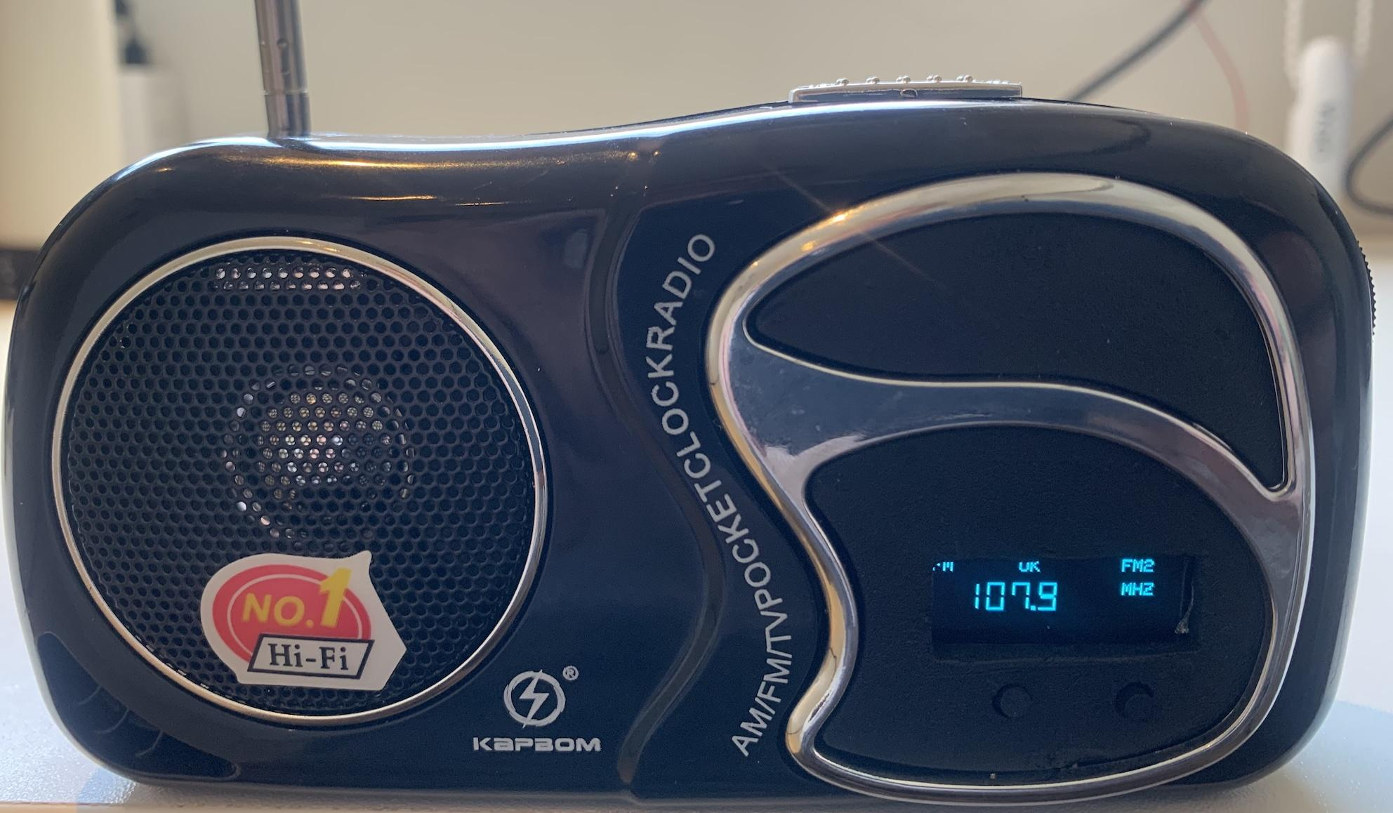
Finish

